Slide 1




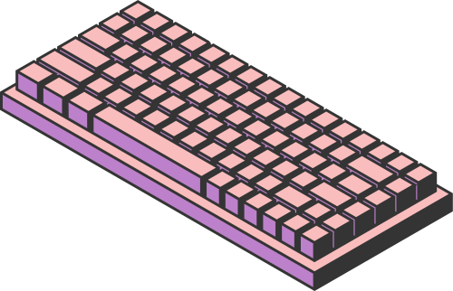
NUMBER
SYSTEMS
BY
EZAMAMTI RONALD A
S23B23/018

Slide 2
NUMBER SYSTEMS
Number systems are methods of representing numerical values.
They have evolved from ancient counting systems to modern digital
representations.
They are thus essential in computing and digital circuit design.
Types of Number Systems
Decimal (Base-10)
Binary (Base-2)
Octal (Base-8)
Hexadecimal (Base-16)
Binary Coded Decimal (BCD)

Slide 3
NUMBER SYSTEMS APPLICATIONS
Decimal: Most commonly used in daily life.
Binary: Used in digital electronics and computing.
Used in logic circuits and programming.
Octal: Sometimes used in digital systems for compact representation.
Used in microprocessor and system design.
Hexadecimal: Used for color coding. e.g(#FF57339)
Used in memory addressing and debugging.
BCD: Represents decimal digits in binary format.
Used in digital clocks and calculators.

Slide 4
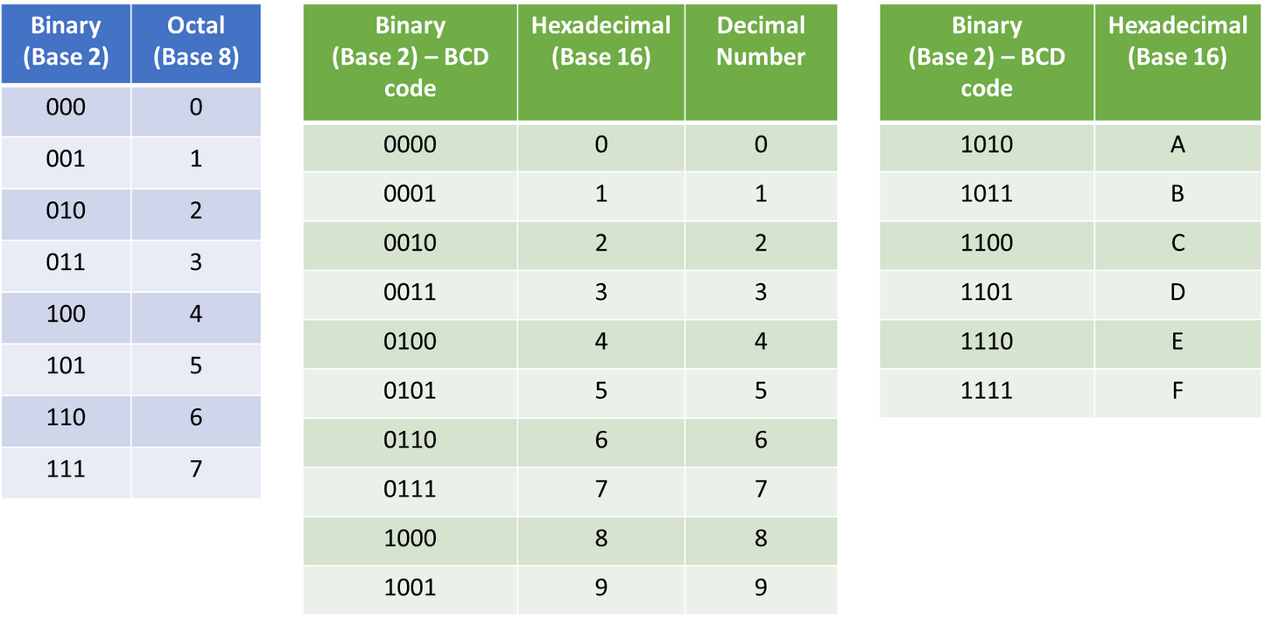
NUMBER SYSTEMS REPRESENTATIONS

Slide 5
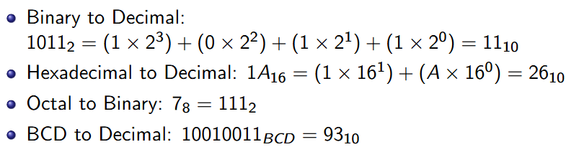
NUMBER SYSTEM CONVERSIONS
Binary to Decimal: Sum the place values.
Hexadecimal to Decimal: Multiply each digit by powers of 16.
Octal to Binary: Convert each octal digit to a 3-bit binary.
BCD to Decimal: Convert each 4-bit group to its decimal
equivalent.
Examples

Slide 6
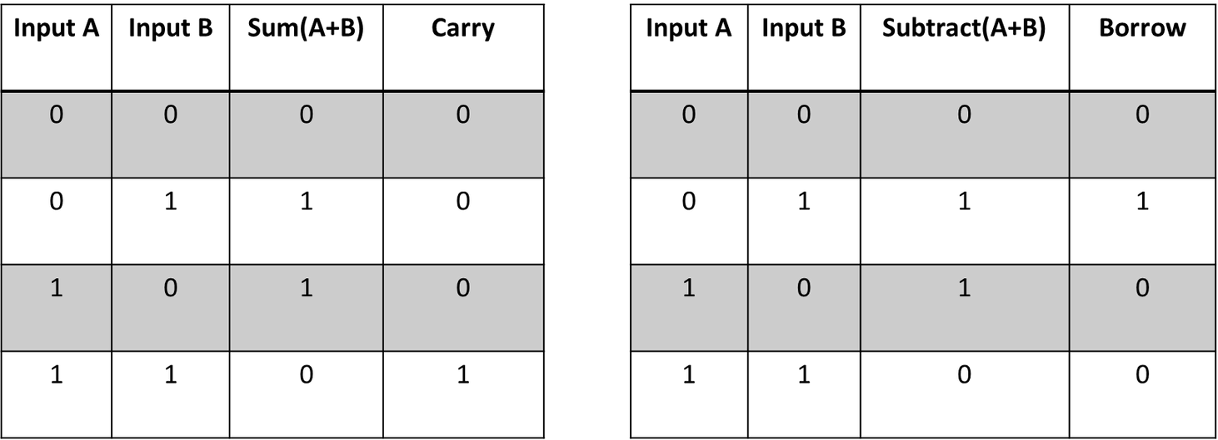
BINARY ARITHMETIC OPERATIONS
Addition: Follows rules of carrying.
Subtraction: Uses borrowing like decimal subtraction.
Multiplication: Follows the same pattern as decimal multiplication.
Division: Similar to long division in decimal.

Slide 7
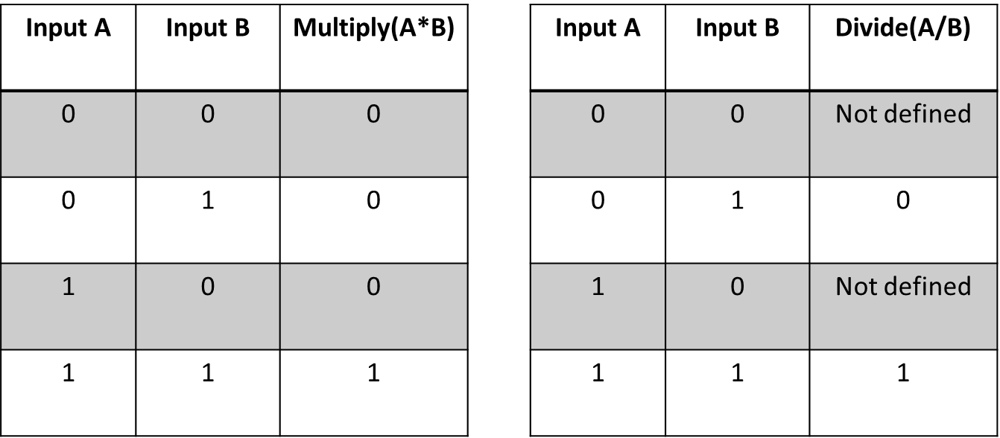
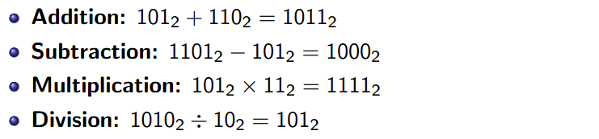
BINARY ARITHMETIC OPERATIONS

Slide 8
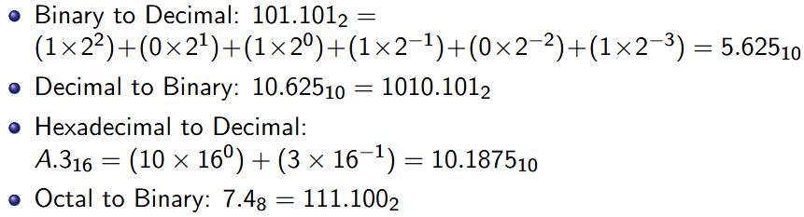
MORE EXAMPLES
THE END

